Slide 1
Understanding Macro

Slide 2
The 3 central questions
Why do output and employment sometimes fall, and how can unemployment be reduced?
What are the sources of price inflation and how can it be controlled?
How can a nation increase its rate of economic growth?

Slide 3
Distinguishing between business cycle and growth?

Slide 4
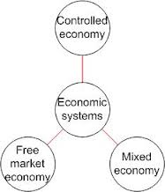
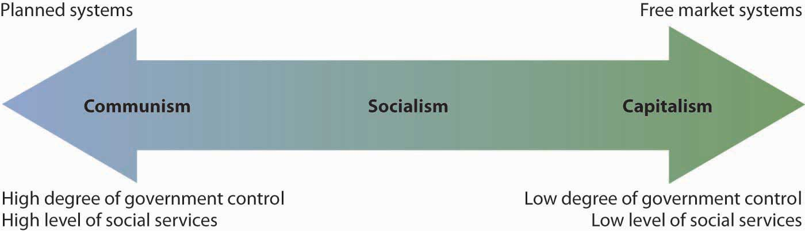
Economic Systems
How the Government influences how I make money.

Slide 5
Quick Review:
Answer the following questions:
What are Goods?
What are Services?
What are Resources?
What is Scarcity?

Slide 6
Economic Systems
Def. The method used by a society to produce and distribute goods and services.
Or, How the government tells us what we can get and how to get it!

Slide 7
All Economic Systems Must Consider the Following Questions:
What goods and services to produce?
How will they produce them?
Who will get them?
How much will they produce now, and how much later?
Each economic system answers these questions in a DIFFERENT WAY.

Slide 8
Types of Economic Systems
There are 3 basic types of economic systems.
Traditional
Capitalist
Socialist
Mixed

Slide 9
1. Traditional Economy
Economic questions are answered by habits and customs (the way it has always been done)
Children work the same jobs parents worked, often farming or shepherds
Fear Change!

Slide 10
2. Command Economy
The government answers the basic economic questions
Advantages: able to act quickly in emergencies, provide for all people equally
Disadvantages: Inefficient, no incentive to work hard or be creative
Ex. Communist Countries (China, Vietnam, North Korea, former Soviet Union, Cuba)

Slide 11
3. Free Market Economy
Economic questions are answered by individual buyers and sellers.
Supply and demand influence economy
People act out of self interest; motive for profit (money) drives the economy
Also known as FREE ENTERPRISE or CAPITALISM
Ex. The United States, Western Europe, Japan

Slide 12
Features of Free Market Economy
Economic Freedom: individuals have the right to choose
Competition: more than one producer of good/services insures choice
Private Property: individuals have the right to own their own property, including business

Slide 13

Features of Free Market Economy
Self-Interest: individuals make
decisions based on what is best for them
Voluntary Exchange: individuals may freely buy and sell goods
Profit Motive: individuals are driven by a desire to profit (make money)

Slide 14
4. Mixed Economy
Mixed Economy: No economy is pure market, pure command or pure traditional, elements of each appear in all economies, some have more elements of one economy than another.
Market Mixed Command
USA India China

Slide 15
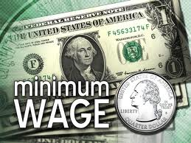


Features of American Command Economy
Government regulation of some business practices
Ex. Wages, labor hours,
safety practice.
Government limits certain choices
Ex. Cannot buy or produce certain goods/services
Government provides aid to the needy
Ex. Medicare, Medicaid, welfare

Slide 16
My Pizza Hut
How would my pizzeria function under different economic systems?

Slide 17
My Pizza Hut in a Free Market
I answer the basic economic questions!
I determine how much cheese and pepperoni goes on the pizza
I determine the quality of the cheese and pepperoni
I set my employees wages
I set my business hours

Slide 18
My Pizza Hut in a Command Economy
The government answers the basic economic questions
The government sets the amount of cheese and pepperoni on each pizza
The government determines quality of cheese and pepperoni
The government sets employees wages
The government sets business hours

Slide 19
My Pizza Hut in a Mixed Economy
The Government and I both answer the basic economic questions
I determine the amount of cheese and pepperoni on the pizzas; government determines the quality of cheese and pizza
I set employee wages; government sets minimum wage for employees
I determine business hours; government determines whether I am safe to be open or not

Slide 20
What and How of Macro
Objectives:
Economic growth
High level of employment
Stable prices
Instruments:
Monetary policy
Fiscal Policy
Trade Policy

Slide 21
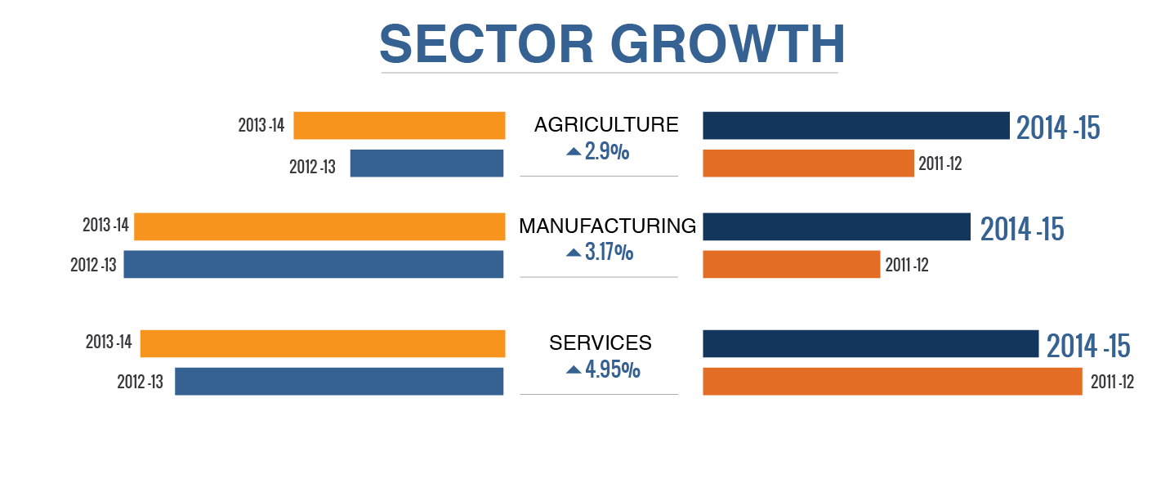
India’s Sectoral growth

Slide 22
Types of macroeconomic variables
Variables in current versus constant prices
Current prices (“nominal”): variable measured in current rupees
Constant prices (“real”): Corrected for inflation
Important price indices in India
Wholesale Price Index (WPI)
Consumer Price Index (CPI)
Current WPI and CPI base year: 2012

Slide 23
Types of macroeconomic variables
Output of the economy - GDP
Inflation rate = growth rate of prices in terms of an appropriate price index
WPI and CPI inflation rates: WPI reported weekly and monthly on a year-on-year basis
Core inflation: Manufacturing sector WPI
Food inflation: WPI/CPI for food articles

Slide 24
India: Components of GDP at market prices
Source: Reserve Bank of India, Data Base of the Indian Economy

Slide 25
Employment

Slide 26
Unemployment in India
Developed country unemployment: Frictional, Cyclical and Structural
Unemployment: % of labour force not having jobs
Labour force: Persons looking for work
Discouraged worker effect: Persons dropping out of labour force.
Anatomy of unemployment in India
Cyclical unemployment of some concern for educated and white collar
Much more serious is underemployment and disguised unemployment
Open structural unemployment is much less serious in India

Slide 27
Labour force participation rate of persons aged 15+: 52.5%
Employment
Self employed: 51% rural, 34% urban, 48.6% overall
Regular wage/salary income: 11% rural, 42% urban, 19.7% overall
Casual labour (31.7%)
Unemployment rate: 4.9%

Slide 28
International flows and the balance of payments

Slide 29
Measuring international flows
The Balance of Payments (BOP) is a complete record of a country's foreign transactions (including transactions in goods, services and assets).
In the BOP account, the Current Account Surplus is balanced identically by the Capital Account Deficit or Net Capital Inflow.
A simplified equation for the BOP is
Exports minus Imports + Net Capital Inflow ≡ 0
In practice, discrepancy is caused by missing data (errors & omissions).

Slide 31
Liberalisation era
Source: Reserve Bank of India, Data Base of the Indian Economy

Slide 32
Foreign Exchange Rates
Rupees per foreign currency unit (e.g. USD)
Appreciation : Rate decreases
Depreciation: Rate increases
Other policy rates
Nominal Effective Exchange Rate or NEER: Weighted average of exchange rates: Weights: Share in trade with India. RBI looks at 6-currency and 36 currency NEERS
6 country NEER: US, Eurozone (12 countries), UK, Japan, China, Hong Kong
Real Effective Exchange Rate or REER: NEER multiplied by ratio of Price indices (WPI or CPI) in the two countries.

Slide 33
Purchasing Power Parity (PPP) exchange rate: “rate at which the currency of one country would have to be converted into that of another country to buy the same basket of goods and services in each country.” (IMF).
India’s rate compared to USD: O.3. Rupee purchasing power is 3.33 times the normal exchange rate with the USD

Slide 34
Rupee REER, NEER and USD rates
High REER and NEER: Rupee is expensive or domestic inflation is high – bad for exports
Source: Reserve Bank of India

Slide 35
The government budget

Slide 36
What is the budget
Record of the revenues and expenditures of a government during a given period of time.
Budget estimate: what the govt intends to do during that period and how it intends to finance these activities.
Revised estimate and actuals: what the govt actually did, who had to pay for it and in what form.
Key features
Budget is a legal document approved by the legislature or equivalent institution
Budget is the key document outlining fiscal policy

Slide 37
The government budget identity
Expenditure less (non-debt) receipts ≡ Fiscal Deficit
or G + TR – TI – TP – NTR – RA ≡ Fiscal Deficit
Expenditure (G) +
Net Transfers (TR) –
TI (Net Indirect Taxes) –
TP (Personal Taxes) –
NTR (Non-Tax Revenue) –
RA (Receipts from Asset Sales) ≡ Fiscal Deficit
Note: RA is not part of current income or production

Slide 38
Receipts and expenditure of the Central Government (% of GDPfc)
Source : Union Budget documents and Controller General of Accounts as reported in Economic Survey, 2014.
BE : Budget Estimates P: Provisional Actuals (Unaudited)

Slide 39
References

Slide 40
Government of India, Ministry of Labour and Employment (2012) Report on Labour and Employment Survey 2011-12, Chandigarh: Labour Bureau.
Goldar, B. and V. S. Renganathan (2008) Import Penetration and Capacity Utilization in Indian Industries, New Delhi: Institute of Economic Growth.
Mukherjee, Atri and Rekha Misra (2012), Estimation of Capacity Utilisation in Indian Industry: Issues and Challenges, RBI Working Paper Series, WPS (DEPR) 5/12.
Ministry of Statistics and Programme Implementation (2008) National Accounts Statistics: Manual On Estimation Of State And District Income, 2008, http://mospi.nic.in/mospi_new/upload/national_accounta.pdf accessed September 25, 2014.
India’s Balance of Payments: Economic Survey, Ministry if Finance. Latest: http://indiabudget.nic.in/es2013-14/echap-06.pdf.
Basu Kaushik (2011), Understanding Inflation and Controlling It, Economic and Political Weekly, October 8, 50-64.
Samuelson, et. al.(2010), Economics, 19/e, Special Indian Edition, New Delhi: Tata McGraw Hill .
Ernst and Young, India (2014) India’s Growth Underperformance: Diagnosis and Revival, unpublished presentation slides.

